Slide 1
Automation of DTT, RUS and DART (AMS Factory)
Author : Vishal Puri

Slide 2
Pre-requisites
Add column named “Backlog” (Yes/No) in DTT for identifying backlog tickets(Column – “U”).
Export the open and closed tickets from the BISM for the current week. Save it with the given names – “OpenTickets.xlsx” and “ClosedTickets.xlsx”. Keep the files in the same folder.
Make all the three sheets Macro Enabled (*.xlsm) by saving the file as “Macro Enabled Workbook”.
Create file named “ProcessedTickets.xlsx” in the same folder. Name column “A” as “Processed Tickets” and maintain the processed tickets of the team.
Updating the names of the team members in the macro code in DTT Macro code.
Line 6 – Paste the BI names of the team members present in the BISM tool.
Line 8 – Paste the enterprise ids which you maintain in the DTT
For Month Start DTT preparation – Keep the “Backlog tickets” sheet of the current month in the same folder and run the code.
Pasting the code
Insert new modules(by pressing Alt+F11, click on Insert->Module), rename and paste the code in given files,
DTTMacro code – DTT sheet
MonthStart_BacklogPrepMacro – DTT sheet
RUSMacro code – RUS Data sheet
DartMacro code – Dart sheet

Slide 3
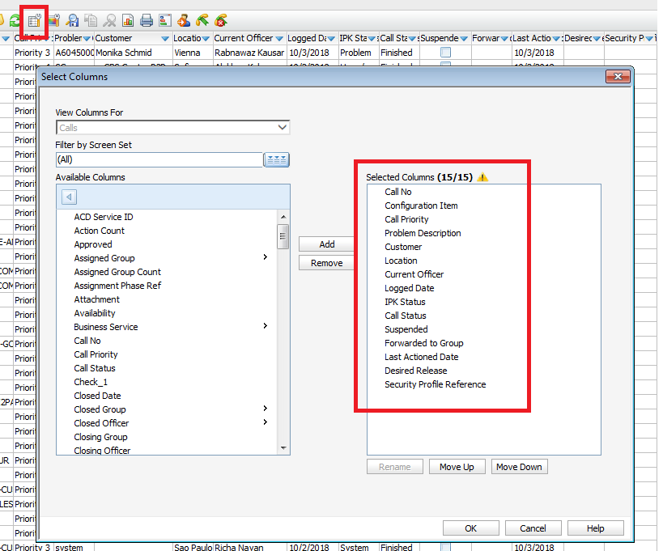
Open and Closed Tickets extract from BISM
Keep the below order of the columns in the search criteria mentioned in the BISM. The code is configured with this order of columns only.

Slide 4
DTT Macro - Functionality
Check the unique open tickets in OpenTickets.xls and DTT base file.
Paste the new tickets and populate their respective fields.
Check the unique closed tickets in ClosedTickets.xls and DTT base file.
Paste the new tickets and populate their respective fields.
Update all the ticket’s statuses and current officers in the base DTT file.
Format the DTT file.

Slide 5
RUS Macro - Functionality
Check the unique tickets from updated DTT file.
Populate and format the new tickets and their required fields.
Update all the ticket’s statuses and current officers using the DTT sheet.

Slide 6
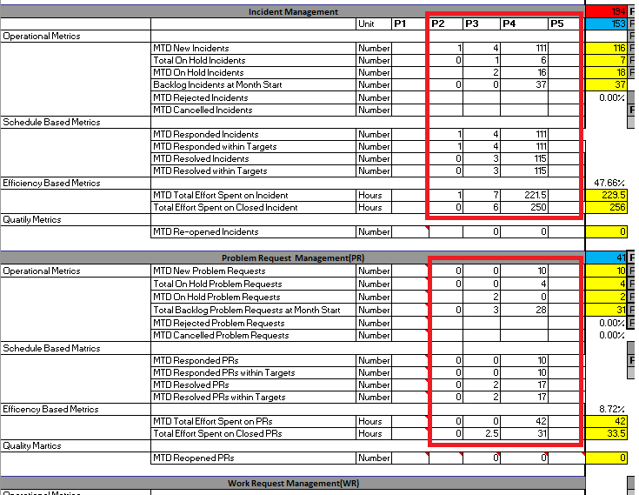
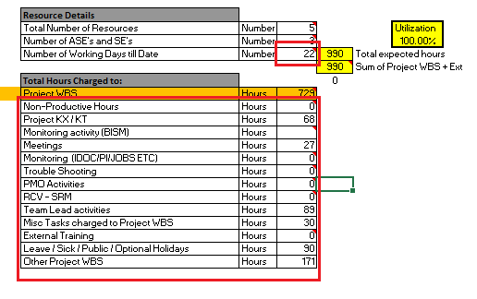
DART Macro – Functionality
Update the number of working days.
Populate all the required fields
from updated RUS sheet (Fig. 1).
Populate all the
required fields from
updated DTT sheet (Fig. 2).
Fig. 1
Fig. 2

Slide 7
Month Start Macro – Functionality
Delete all the closed tickets from the DTT sheet and format the sheet.
Compare the backlog tickets with the “Backlog Tickets file of current month” for any discrepancies.
Show error message with the ticket numbers if any discrepancy found in “Month Start DTT” sheet and “Backlog tickets of current month” sheet.

Slide 8
Manual steps
Fill “Main Category“, “Sub Category 1 - Affected Area/Impacted Business Process” and “Sub Category 2 - Description” fields in the DTT sheet for newly added tickets.
Add the hours for resources in the RUS sheet.

Slide 9
Thank You!

